Slide 1

Lecture-3
Inter-Process Communication & Synchronization
Core Topics:
IPC- Visual Selection, Shared Message
Threads- Advantage, Threads vs Process
Semaphore- Critical Section Problems
Deadlock

Slide 2


Inter-Process Communication or IPC is a mechanism that allows processes to communicate. It helps processes synchronize their activities, share information, and avoid conflicts while accessing shared resources.
Inter Process Communication (IPC)

Slide 3
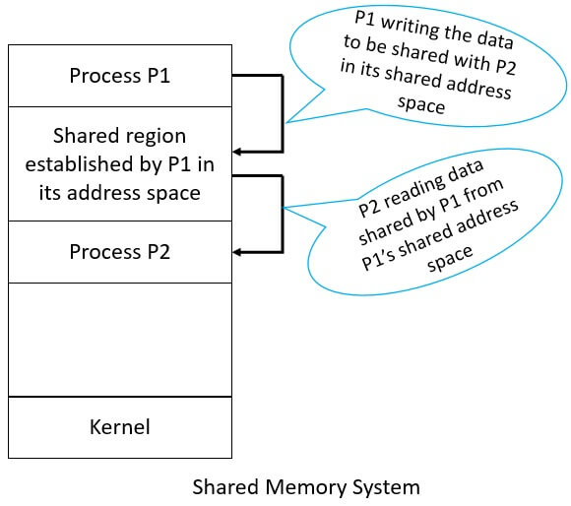
Shared Memory in IPC
The Shared memory is a memory segment that multiple processes can access concurrently. It is one of the fastest method because the processes communicate by the reading and writing to a shared block of the memory.
Advantages | Disadvantages
Shared memory is the fastest IPC method | Concurrency Issues
No Kernel Intervention | Complexity
Ideal for Large Data Transfers | Debugging Difficulties
Lower Latency | No Built-in Synchronization
No Network Stack Involved | Limited Portability

Slide 4
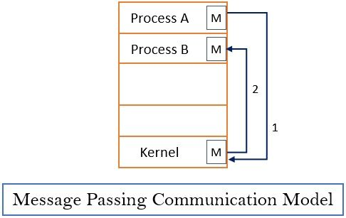
Message Passing in IPC
In this method, processes communicate with each other without using any kind of shared memory.
Advantages | Disadvantages
Processes easily sending and receiving messages. | Message passing can introduce significant overhead and latency, especially
Asynchronous Communication | The asynchronous nature of message passing can make debugging and testing more challenging.
Message passing can ensure message delivery through mechanisms like retransmission. | Potential for Deadlocks
Well-suited for large-scale systems and distributed architectures | Performance Bottlenecks for high-performance applications.
reducing the risk of synchronization problems. | Increased System Complexity

Slide 5
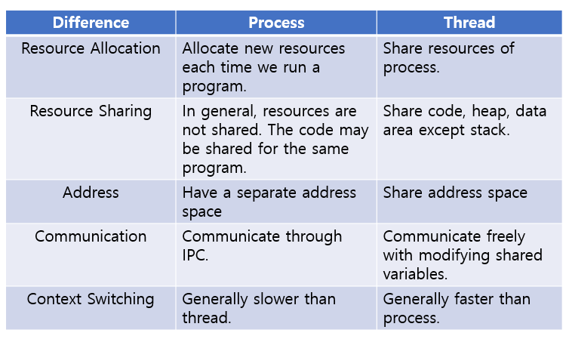
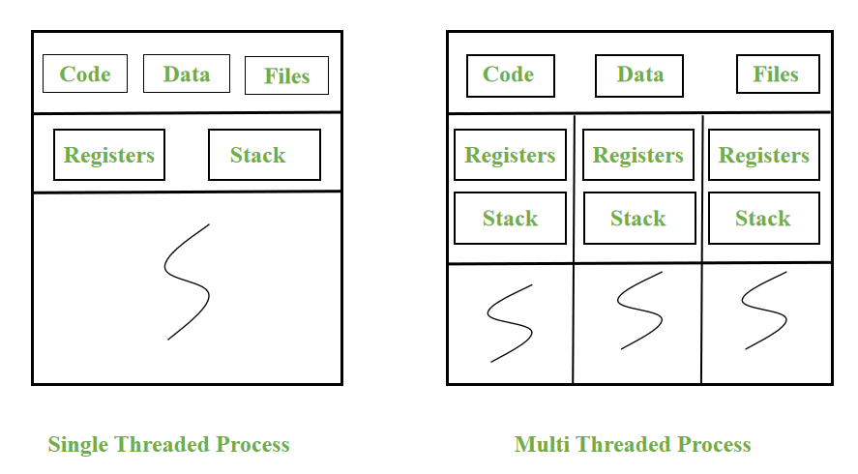
Processes Vs Thread

Slide 6
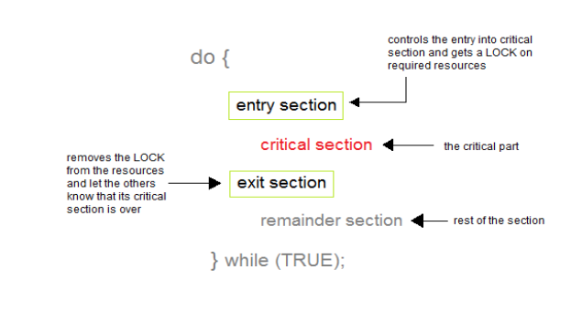
Process Synchronization
Process Synchronization means sharing system resources by processes in a such a way that, Concurrent access to shared data is handled thereby minimizing the chance of inconsistent data.
Critical Section is a code segment that accesses shared variables and has to be executed as an atomic action.
A race condition occurs when multiple threads or processes access shared data concurrently, and the program’s outcome depends on the execution order.

Slide 7
Mutual Exclusion: Out of a group of cooperating processes, only one process can be in its critical section at a given point of time
Synchronization Criteria
Progress: a) Satisfy Mutual Exclusion
b) Willing process will enter in critical section
c) No deadlock in remainder section
Bounded Wait: After a process makes a request for getting into its critical section, there is a limit for how many other processes can get into their critical section, before this process's request is granted. So, after the limit is reached, system must grant the process permission to get into its critical section.

Slide 8
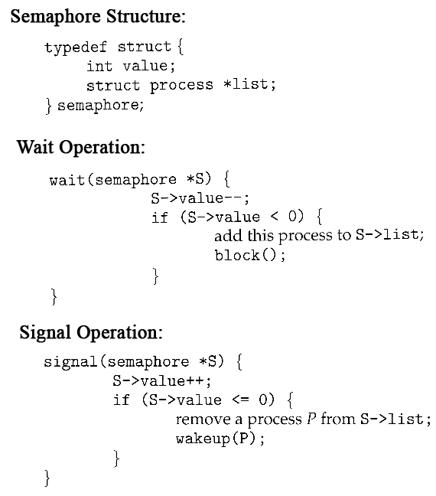
Semaphore
Semaphore is a synchronization tools. It is a variable which can hold only a non-negative Integer value, shared between all the threads, with operations wait and signal.
Wait: Decrements the value of its argument S, as soon as it would become nonnegative (greater than or equal to 1).
Signal: Increments the value of its argument S, as there is no more process blocked on the queue.

Slide 9
Properties & Types Semaphore
Properties of Semaphores:
1. It's simple and always have a non-negative Integer value.
2. Works with many processes.
3. Can have many different critical sections with different semaphores.
4. Each critical section has unique access semaphores.
5. Can permit multiple processes into the critical section at once, if desirable
Types of Semaphores: Semaphores are mainly of two types:
Binary Semaphore: It is a special form of semaphore used for implementing mutual exclusion, hence it is often called a Mutex. A binary semaphore is initialized to 1 and only takes the values 0 and 1 during execution of a program.
Counting Semaphores: These are used to implement bounded concurrency

Slide 10
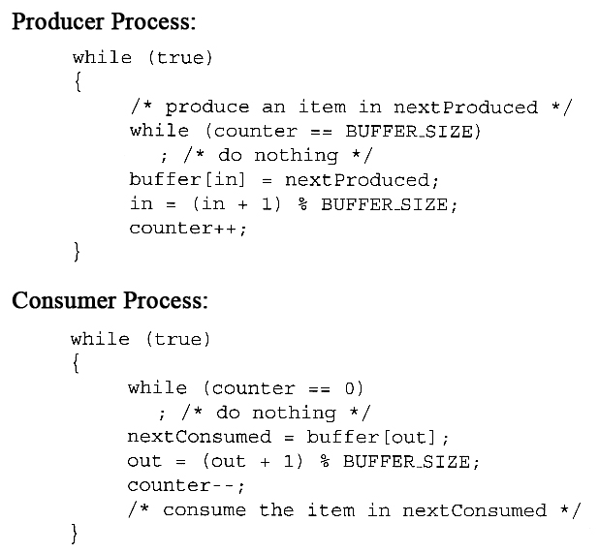
Producer-Consumer Problem

Slide 11
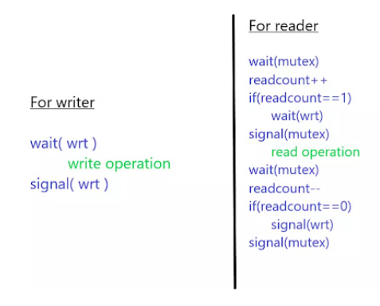
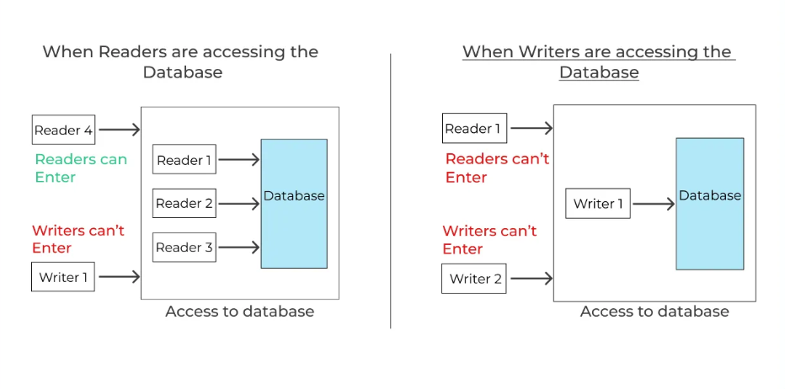
Reader Writer Problem

Slide 12
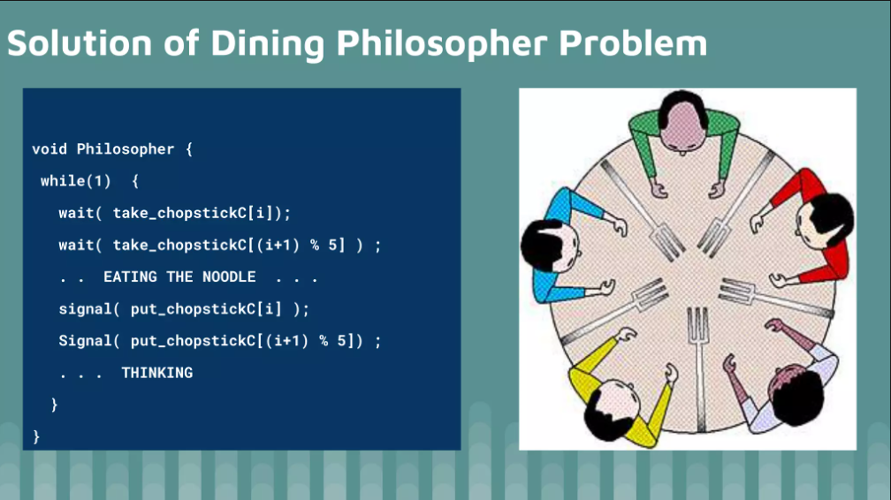
Dining Philosopher

Slide 13
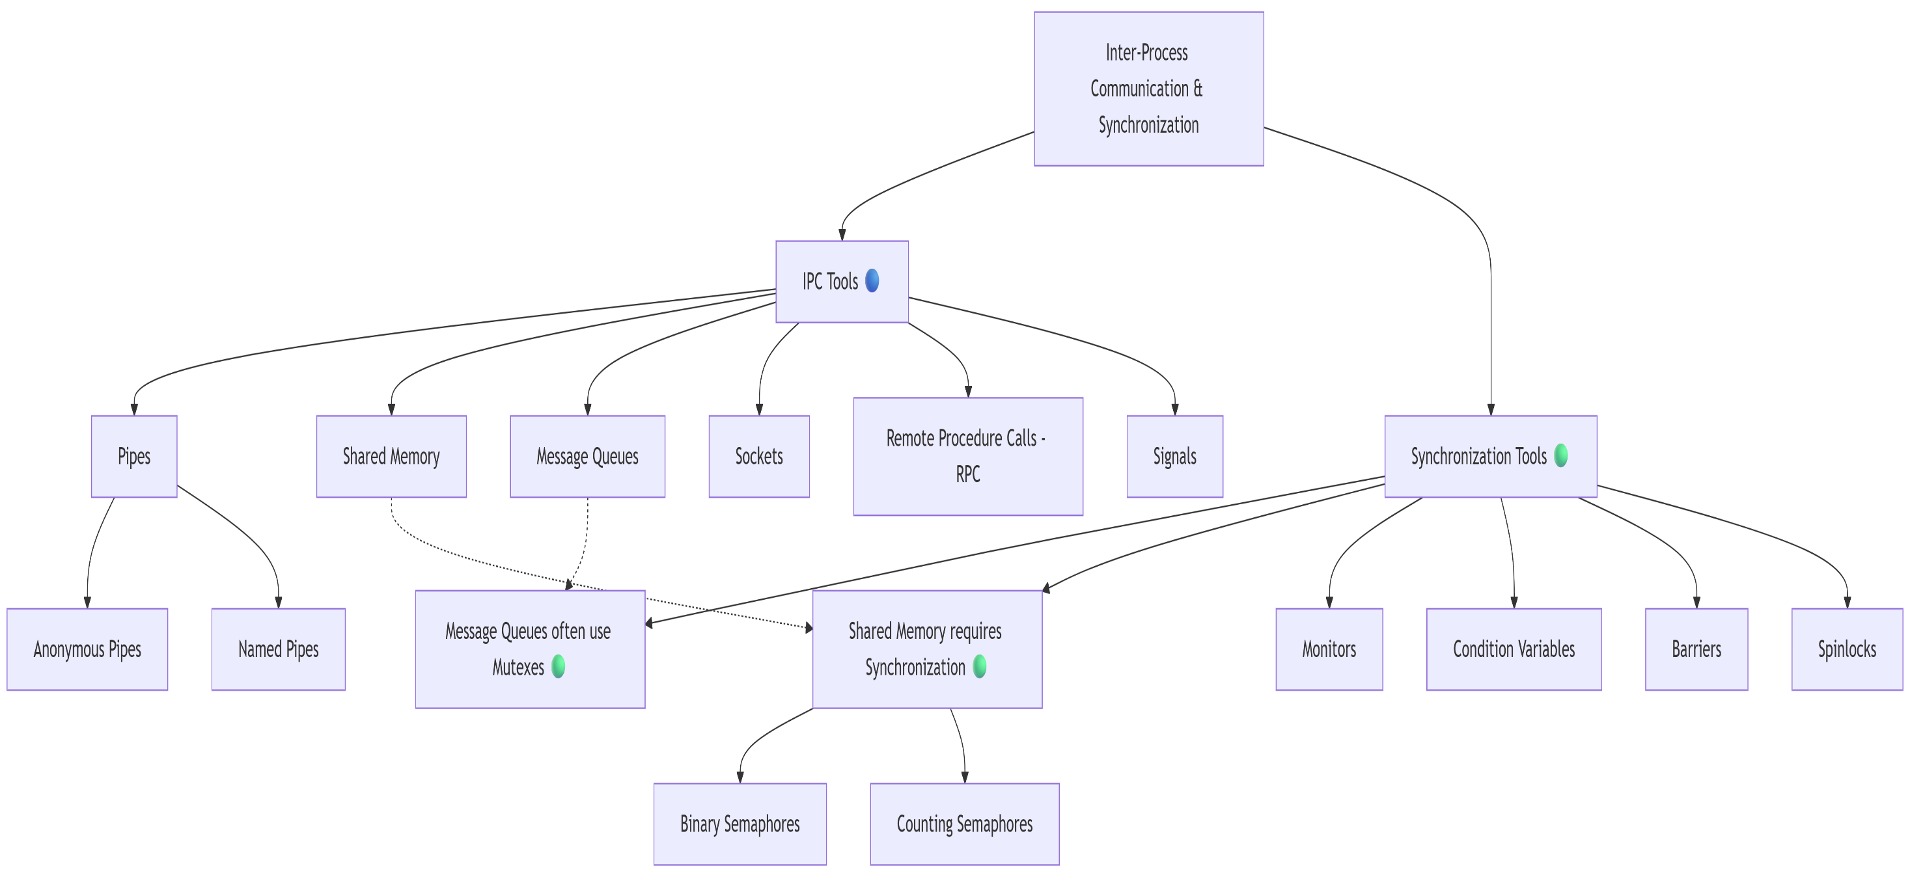
Activity Slow Learner

Slide 14
Activity Slow Learner
Two processes need to exchange data on the same machine. One is a parent process, the other is its child. Which IPC tool should they use? Explain why.
2.A critical resource (e.g., a printer) can only serve one process at a time. Which synchronization tool ensures exclusive access? How does it work?
3.Two processes use Shared Memory (🔵) to edit the same file. Why might they corrupt data? Which synchronization tool (🟢) fixes this?

Slide 15
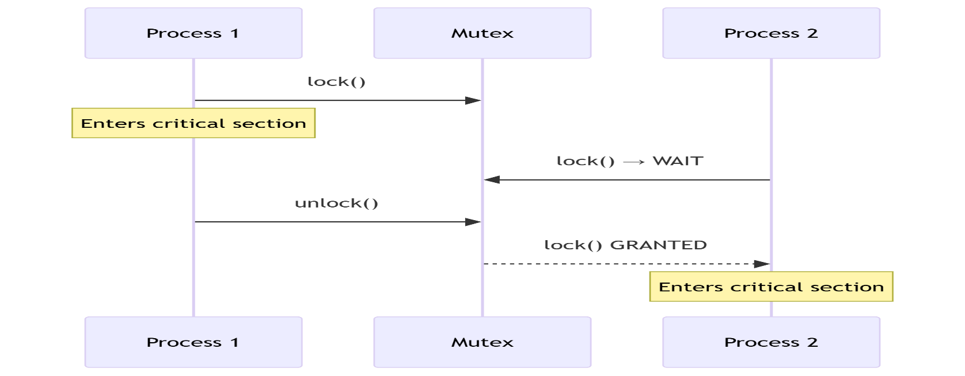
Activity Slow Learner
1. Process A locks a mutex to access a shared printer. What happens when Process B attempts to lock the same mutex?
2. Why must a printer use a mutex instead of allowing concurrent access? What happens without it?

Slide 16
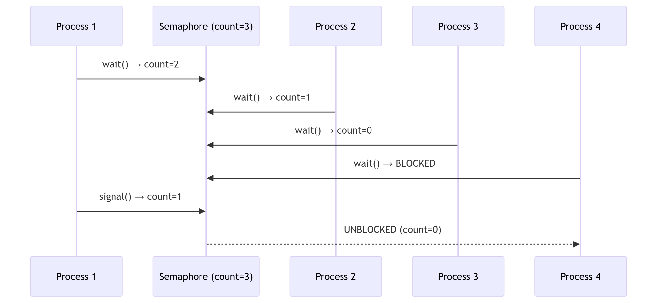
Activity Moderate Learner
1.The semaphore starts with 3 resources. After Processes 1, 2, and 3 each acquire a resource via wait(), how many resources remain? What happens when Process 4 tries to acquire one?
2. After Process 4 is blocked, Process 1 releases its resource with signal(). Why does the semaphore count temporarily become 1 but then drop to 0? What happens to Process 4?

Slide 17
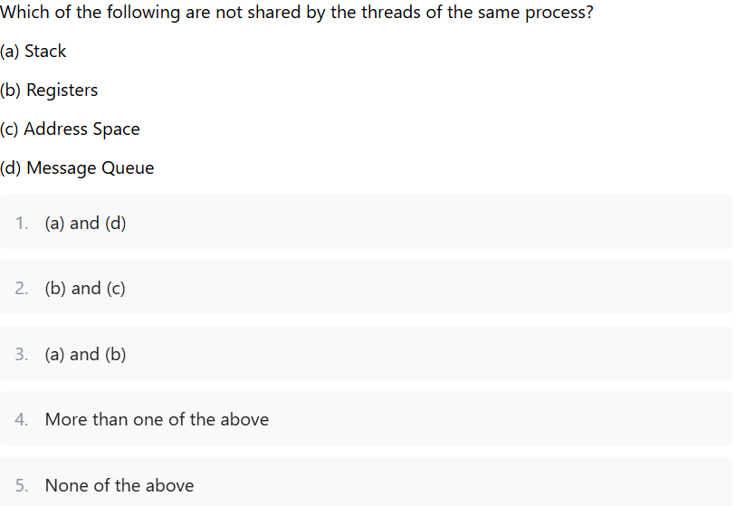
Activity Moderate Learner

Slide 18
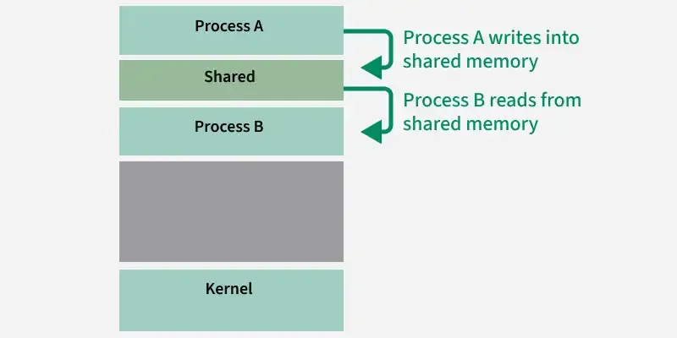
Activity Moderate Learner
1.In the shared memory diagram, if Process A writes data
and Process B reads at the same time without synchronization,
what problem occurs?

Slide 19
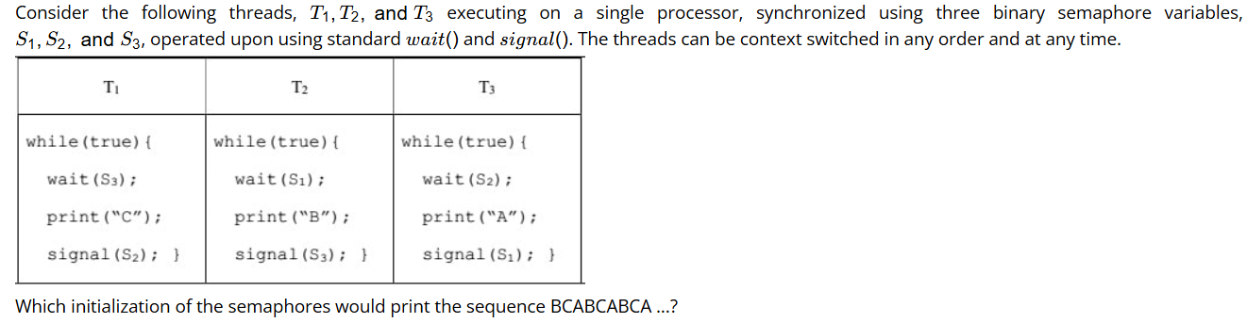
Fast Learner Activity

Slide 20
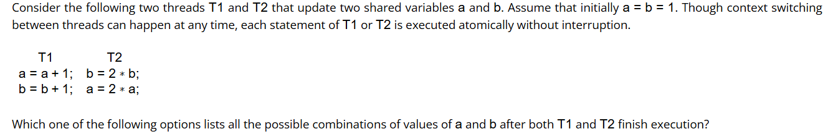
Fast Learner Activity

Slide 21
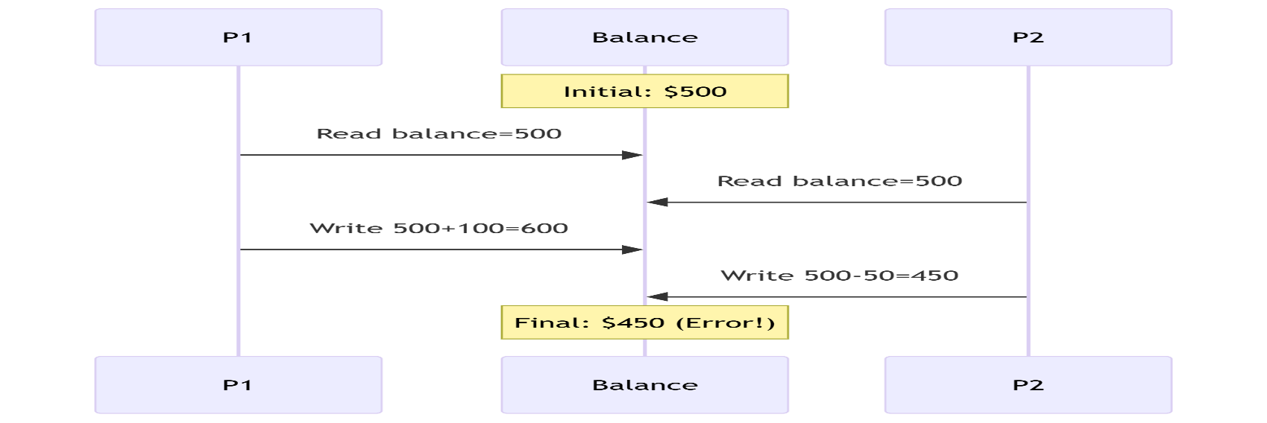
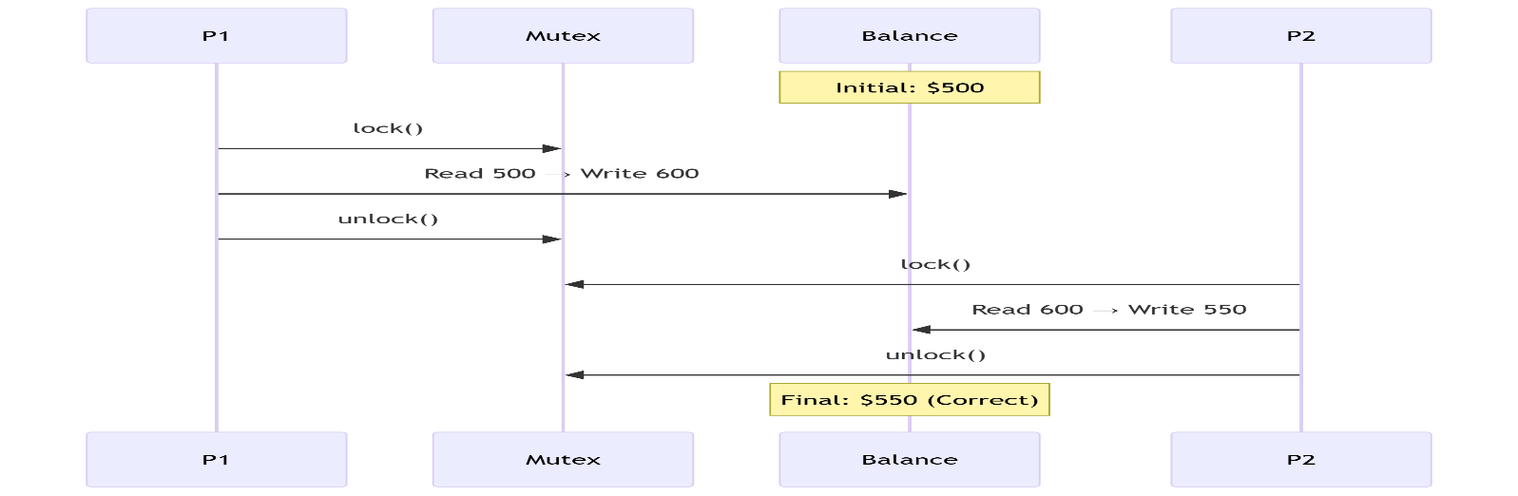
Fast Learner Activity
Based on the diagrams:
Why does the first diagram result in ticket=-1 and double booking?
How does the mutex in the second diagram prevent this?
What synchronization principle does this scenario demonstrate?

